Slide 1
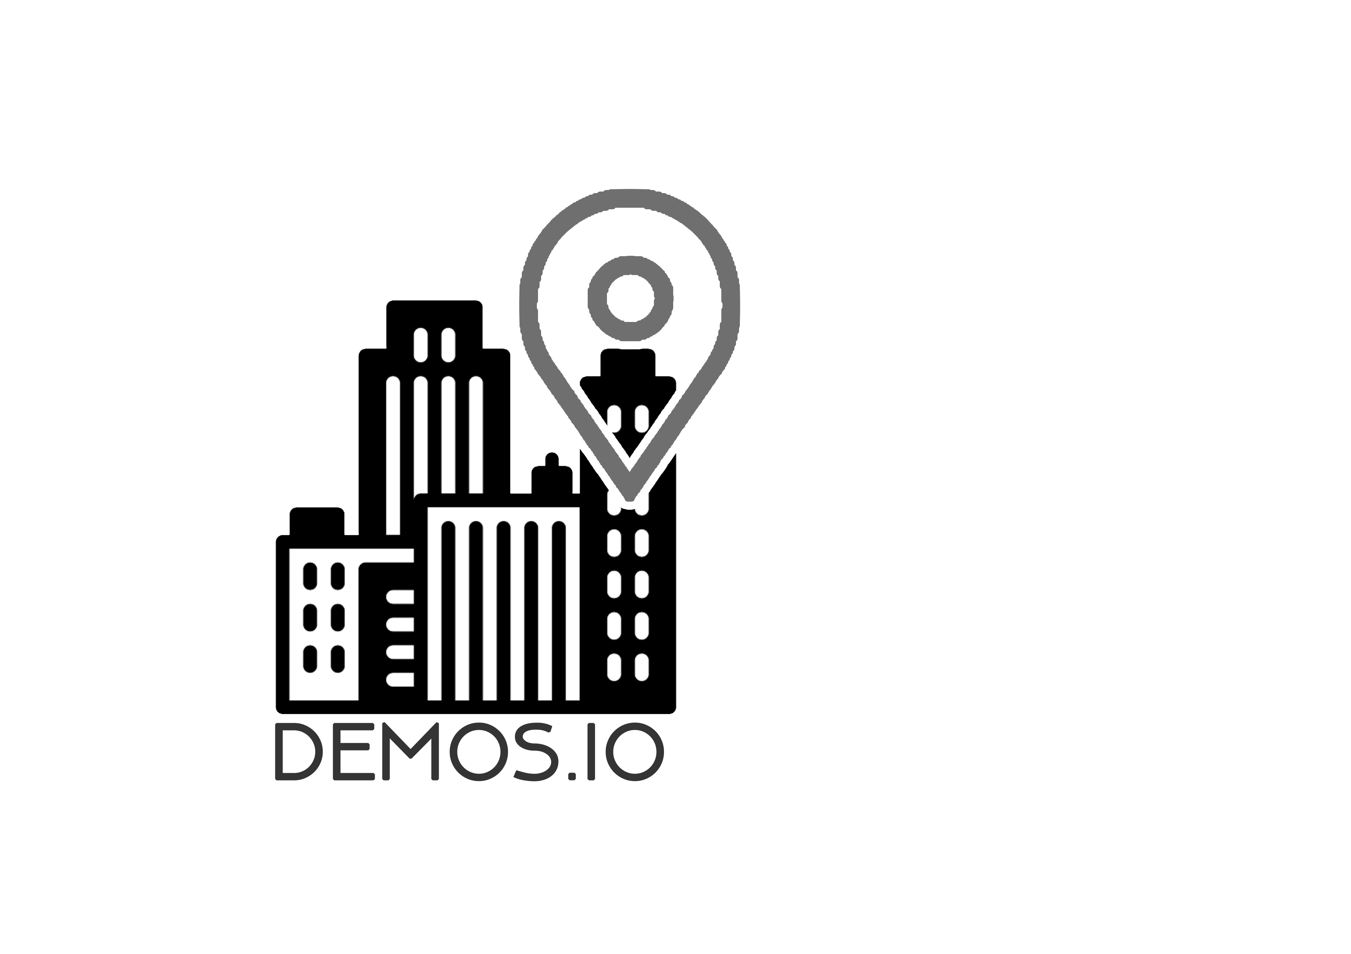
Demos.io
Data Democratisation

Slide 2
Existing Technology
Google Maps
Nearest coffee shop
Show location relationships
Socrata
Data sets collected from local services, businesses and surveys
Limited to governments
Open Data Network and City of Oakland
Notes:
Everyone uses Google Maps. You can use it to find your way around, but it also implements location comparisons. You can ask for a coffee shop near you, or for coffee shops near parks. But what about a coffee shop near parks with the cleanest air? Or coffee shops with the least pedestrian traffic en route?
We need to be utilising more data!
Socrata collects and compiles data sets for almost anything. They make these available to governments to access, for instance the City of Oakland uses these to analyse their local economic and educational development.
What if we made these publicly accessible? Open Data Network also uses Socrata, and is publicly accessible. You can type in the search box and it returns a list of possible matching data sets. This isn’t particularly user-friendly, and requires quite a bit of reading and searching to find what you’re looking for.

Slide 3
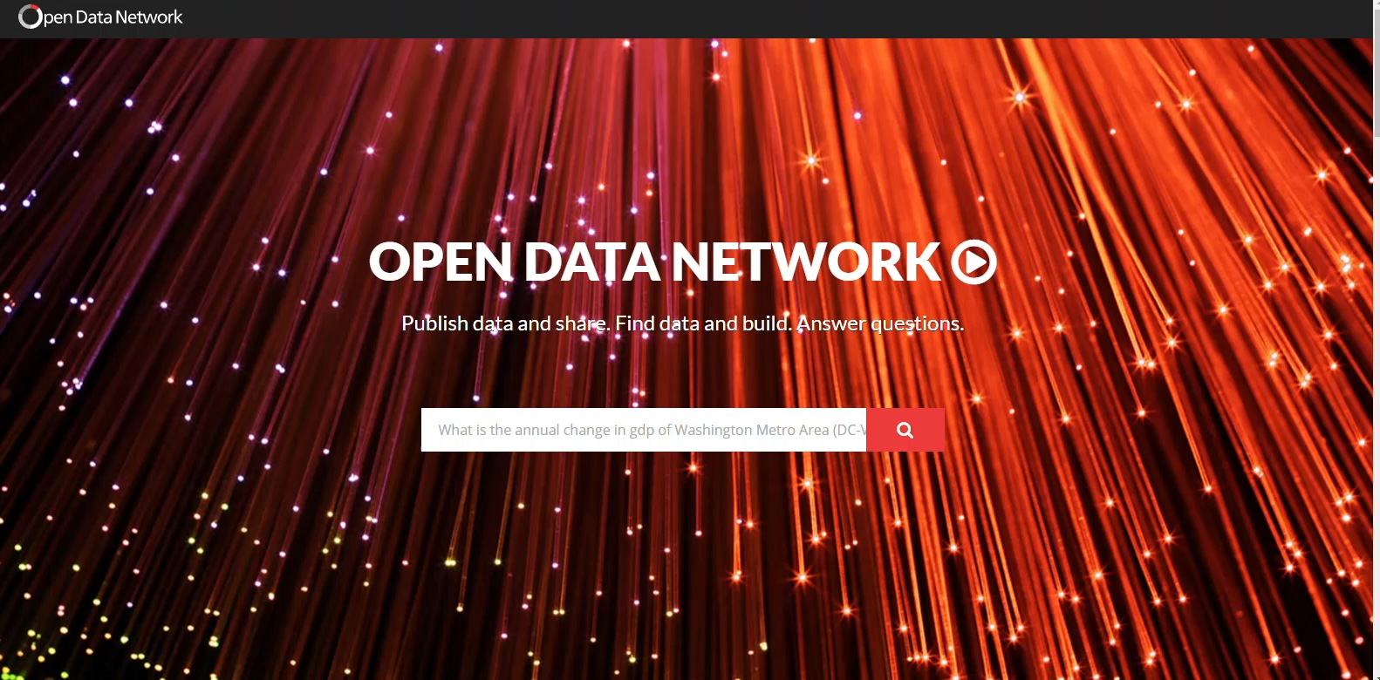
Socrata

Slide 4
What if we combined these technologies?
Make it public
Reward contributing users with increased data access
A platform to make access to these public data sets easy and immediate
Simple interface, Instant results
Notes:
So what if we tied these data to locations, and produced results more similarly to Google Maps? Users would be able to compare almost anything!
Users could layer data to visualise the sets returned.
This application differs from current Smart City technology as it combines existing public data sets, user contribution and sensor feedback, rather than just sensors. This data is customisable by the user to create a bespoke mapping onto their chosen location. This makes the data far more readable and accessible to the public, and puts it into geological context.
Small businesses can use relevant, large and in-high-demand data sets for a fee.
Users can connect their own sensors to the app to contribute data sets. Users that contribute more data are rewarded with more free access.

Slide 5
Semantic Queries
Our platform allows data organisation and correlation
This allows users and applications to make custom queries
Google only allows location comparisons, we allow semantic comparisons
Compare vicinities, prices, traffic, air quality, the combinations are endless
Notes:
Instead of just comparing locations- they can compare all the qualities tied to those locations. This makes it an easily readable information hub. Google Maps only allows location comparisons- we allow semantic. Demos.io is like chatting to a local. It’s in the know.

Slide 6
Document Standardisation
Not just Big Data but Structured Data
To avoid common Big Data issues with unorganised data
This means everyone can mutually contribute to our data sets
Notes:
A key part of demos.io is that users and other applications can contribute too! PokemonGo data can be added, sensors for pedestrian traffic or air purity can be added.
How we’ve made this possible is through document standardisation. Without this module, we would run into many of the issues Big Data faces. We want Structured Data. We want organisation, accessibility, compatibility.

Slide 7
Backend Processing
IoT Device integration
We aim to integrate with IOT device manufacturers
Notes:
we can integrate with iot devices to allow members of the public to install iot devices in homes. The iot devices send the data with the hash of the values appended to the end of the ‘package’. The hash is then encrypted with a public key hardcoded into the device. This means that we keep exclusive control over the devices.

Slide 8
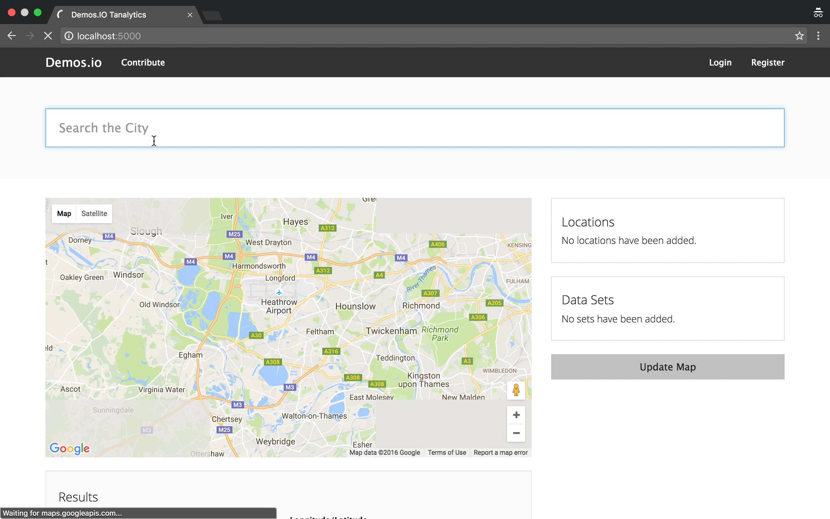
Demos.io DEMO and Technical Overview
Notes:
Sensor: pedestrian traffic
High income areas
Sensor: pollen count
Population density
Pollen count before parks

Slide 9
Who will use it?
Any small business owner
Licences for commonly used data sets
Shop pedestrian traffic
Large companies can License our user-contributed data sets
Pharmaceutical
Users contribute in return for free data use

Slide 10
Possibilities are endless
User contribution allows anyone to add sensor data
Increases span and types of data sets
Allows third party applications to query
Traffic apps
GeoCaching third-party apps
Wildlife conservation

Slide 11
Demos.io
Data Democratisation

Slide 12

Any Questions?

